Slide 1

What new information do we get from climate models with higher resolution?
Gustav Strandberg*, Paula Gonzalez, Galia Guentchev and Gerard van der Schrier
*Swedish Meteorological and Hydrological Institute

Slide 2
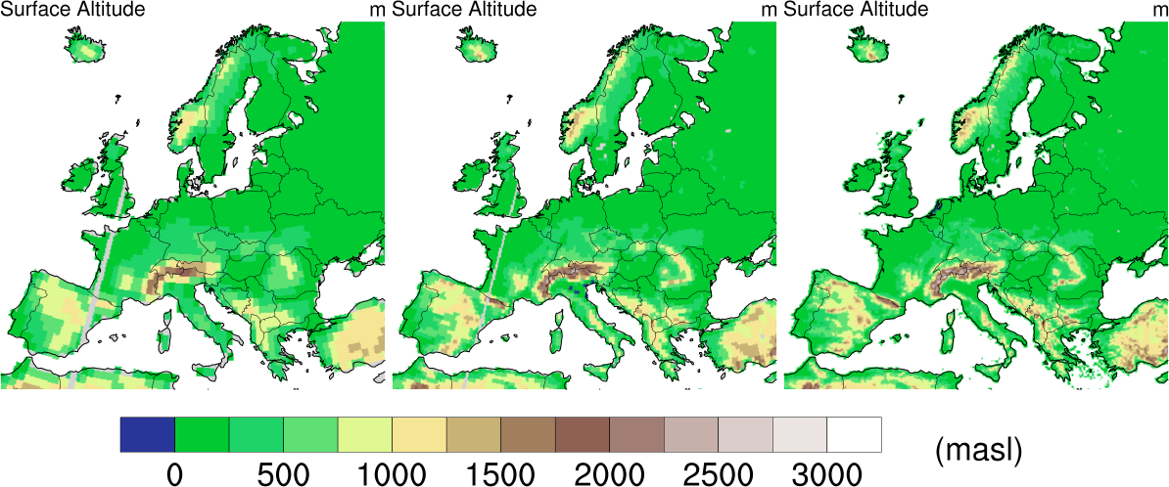
Why is model resolution important?
Primavera low res. ~100 km Primavera high res. ~50 km CORDEX high res. ~12 km
Topography in different models (meter above sea level)

Slide 3
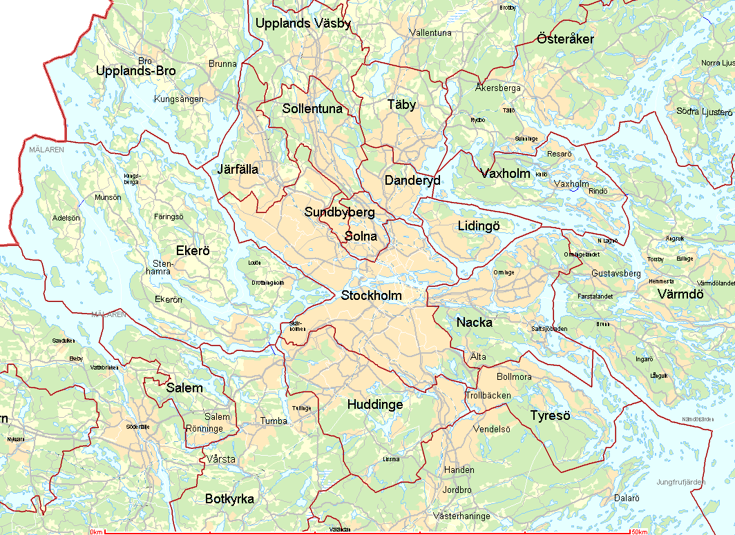
High resolution is expensive
50 km

Slide 4
High resolution is expensive
50 km
25 km

Slide 5
High resolution is expensive
12.5 km
50 km
25 km
Doubling the resolution (e.g. 50 to 25 km) means 8 times the computer power

Slide 6
Some important abbreviations
Model families:
CMIP5 = Global climate models used in the last IPCC assessment
PRIMAVERA = Global models used in the PRIMAVERA project
CORDEX = Regional climate models of higher resolution

Slide 7
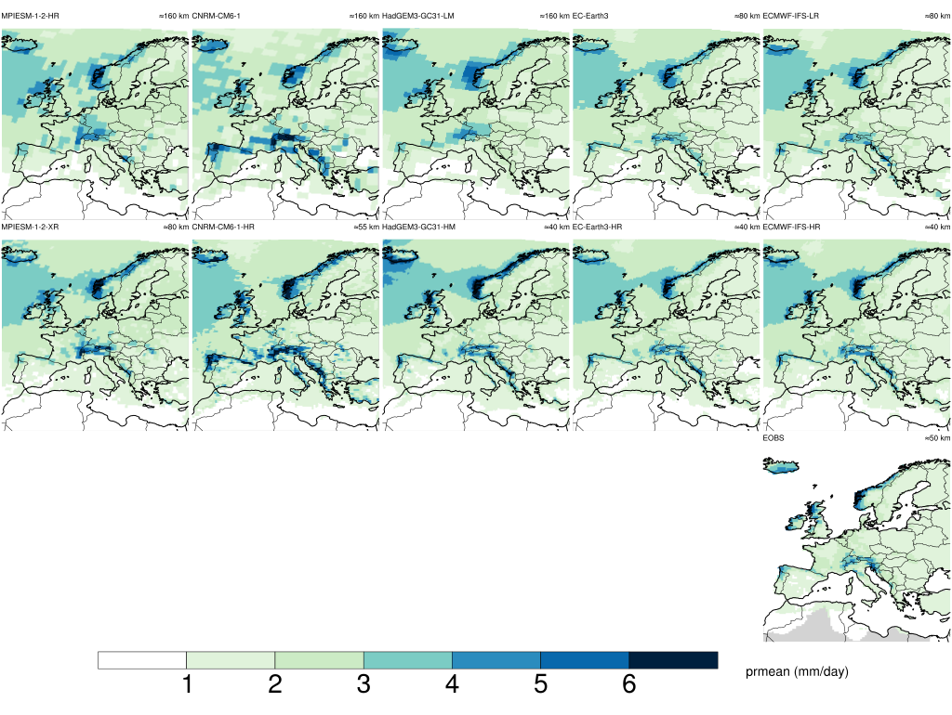
By the looks of it …
Precipitation benefits from higher resolution
MPI-ESM-1-2 CNRM-CM6-1 HadGEM3-GC31 EC-Earth3 ECMWF-IFS
Low res.
High res.
EOBS
Prmean (mm/day)

Slide 8
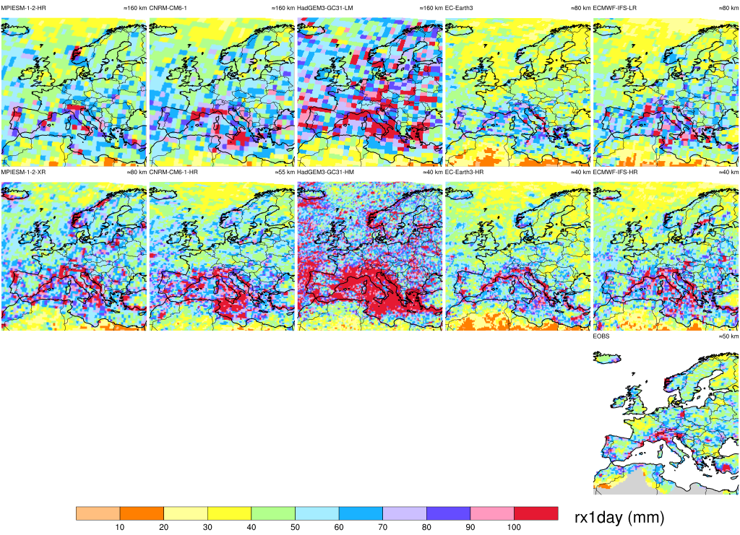
By the looks of it …
Especially extreme precipitation benefits from higher resolution
MPI-ESM-1-2 CNRM-CM6-1 HadGEM3-GC31 EC-Earth3 ECMWF-IFS
Low res.
High res.
EOBS
rx1day (mm)

Slide 9
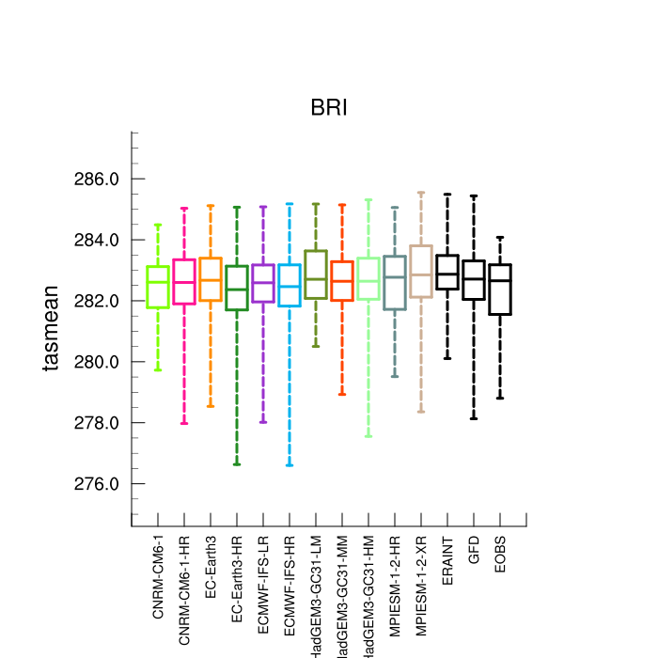
Individual models over a specific region
Temperature
BRI = British Isles
No systematic differences between high and low res. for temperature

Slide 10
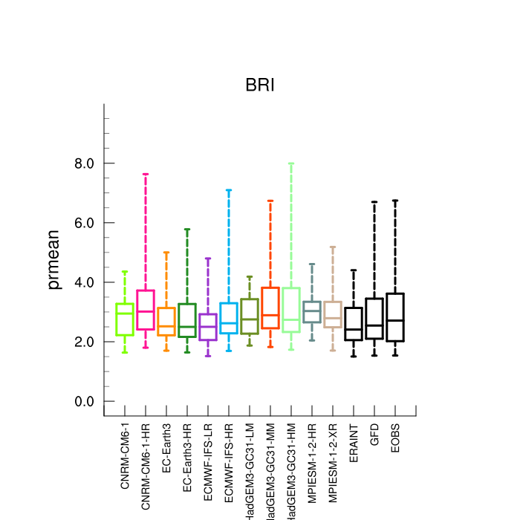
Individual models over a specific region
Temperature
Precipitation
BRI = British Isles
No systematic differences between high and low res. for temperature
Some tendency for more precipitation in high res. Higher maximum precip.

Slide 11
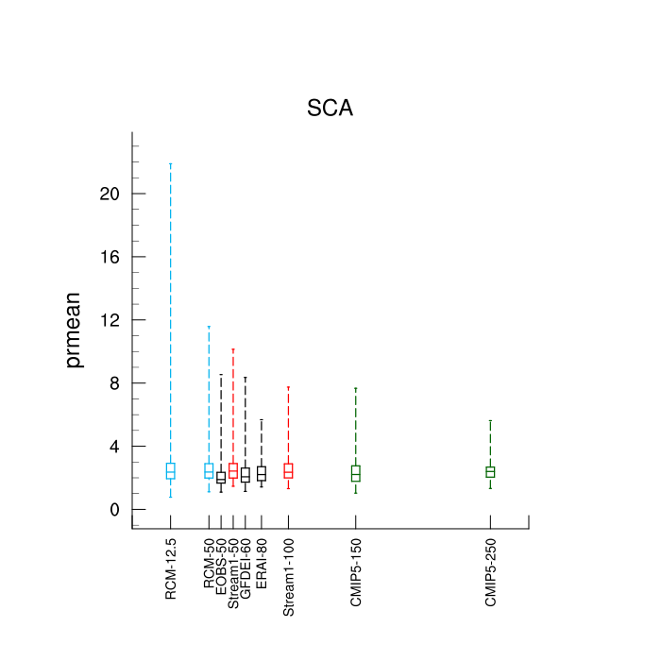
PRIMAVERA in perspective of CMIP5 and CORDEX
Scandinavia
Precip.
High res.
Low res.

Slide 12
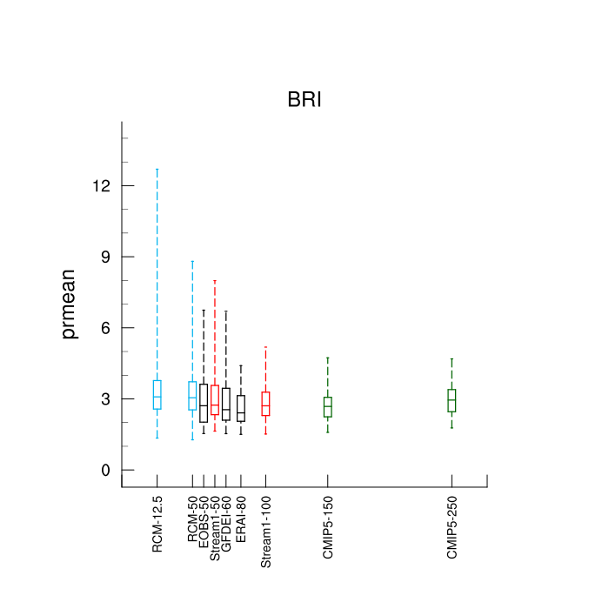
PRIMAVERA in perspective of CMIP5 and CORDEX
Scandinavia
British Isles
Precip.
Precip.
High res.
Low res.
High res.
Low res.
Increasing precipitation with higher resolution is a robust feature over different ensembles

Slide 13
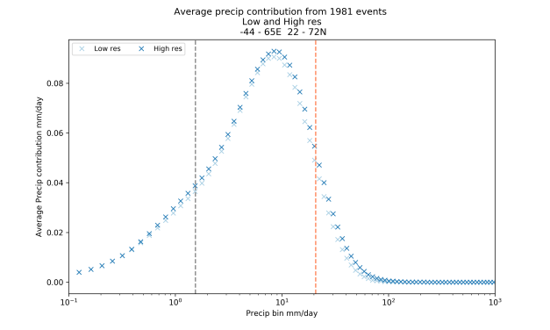
Precipitation intensities
X Low res.
X High res.
Median
99th percentile

Slide 14
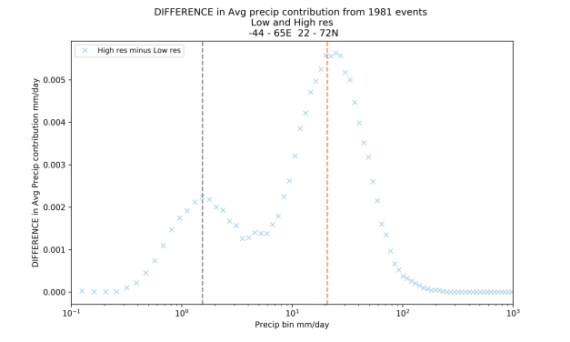
Precipitation intensities
X High res. –
low res.
X Low res.
X High res.
Median
99th percentile
Median
99th percentile
Higher resolution mainly changes precipitation in the high end of the distribution (more extreme precipitation).

Slide 15
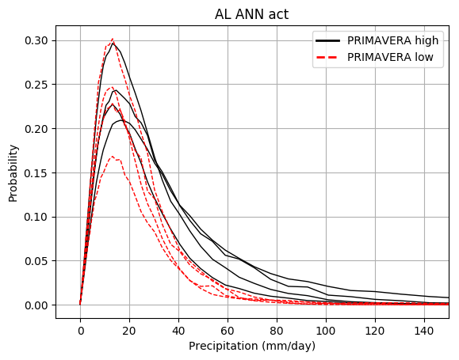
Precipitation intensities
The Alps

Slide 16
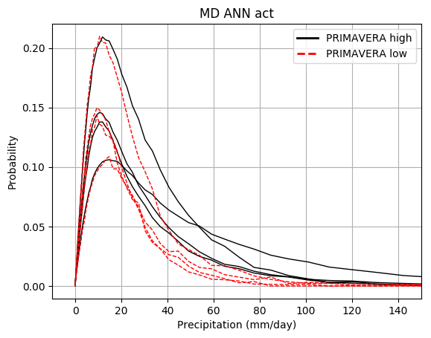
Precipitation intensities
The Alps
Mid Europe
Higher resolution mainly changes precipitation in the high end of the distribution (more extreme precipitation).

Slide 17
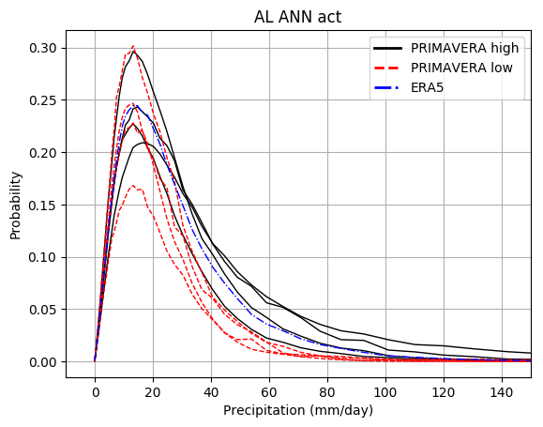
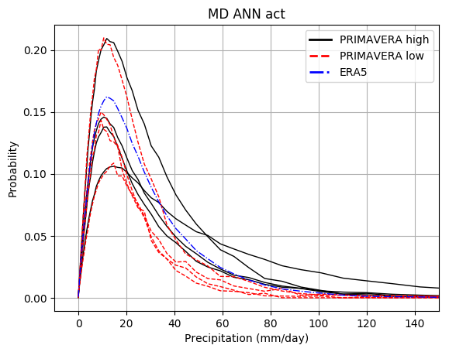
Precipitation intensities
The Alps
Mid Europe
Higher resolution mainly changes precipitation in the high end of the distribution (more extreme precipitation).

Slide 18
Let’s look at extra-tropical cyclones (ETCs)

Slide 19
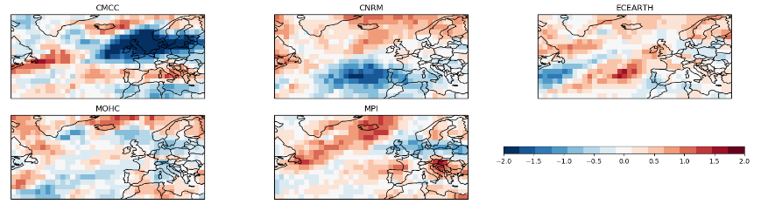
ETC densities
CMCC
CNRM
EC-Earth
Red colours = reduction in bias for PRIMAVERA
MOHC
MPI
Change in storm track bias (as compared to ERA Interim) between CMIP5 and PRIMAVERA models.
Mainly PRIMAVERA models are characterised by smaller biases overall compared to the CMIP5 models

Slide 20
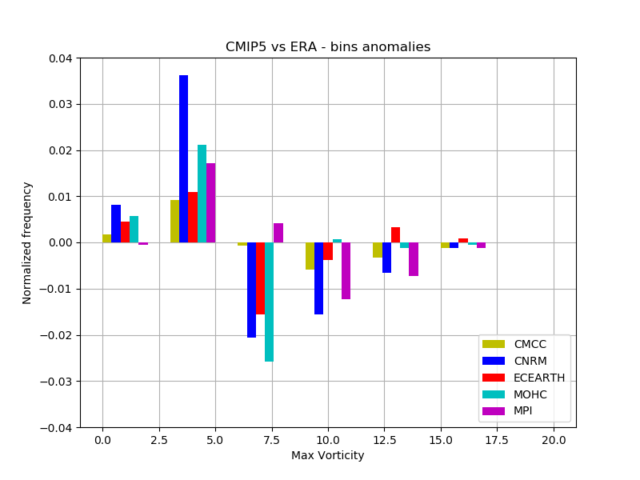
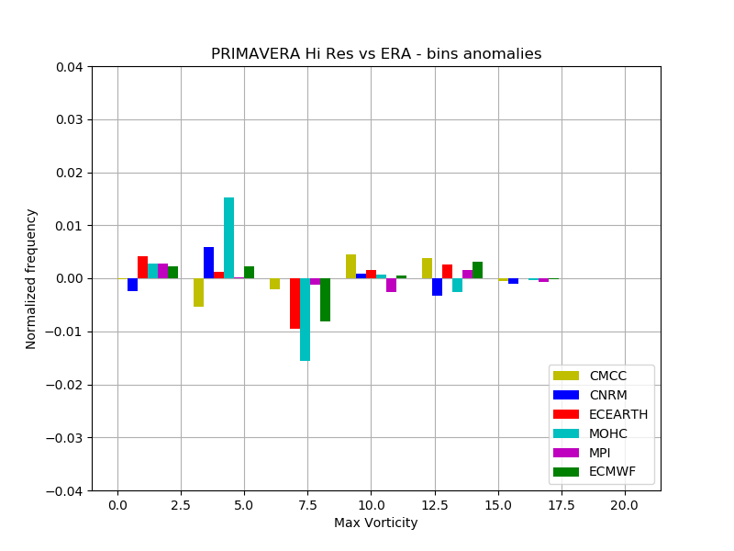
Frequency Anomalies of maximum Vorticity of ETCS
CMIP5 vs ERA
PRIMAVERA vs ERA
Maximum vorticity
Maximum vorticity
Biases are largely reduced in the PRIMAVERA models especially regarding the underestimation of the stronger storms with higher vorticity
Notes:
A large improvement compared to CMIP5 is seen in the distribution of ETC intensities, as PRIMAVERA models better simulate more extreme ETCs. CMIP5 models underestimate the frequency of the stronger storms with higher vorticity and overestimate the frequency of the storms with lower vorticity. The PRIMAVERA models have overcome to a great extent these biases.

Slide 21
Let’s have a closer look at the upper Danube basin
Upper Danube basin and its topography.

Slide 22
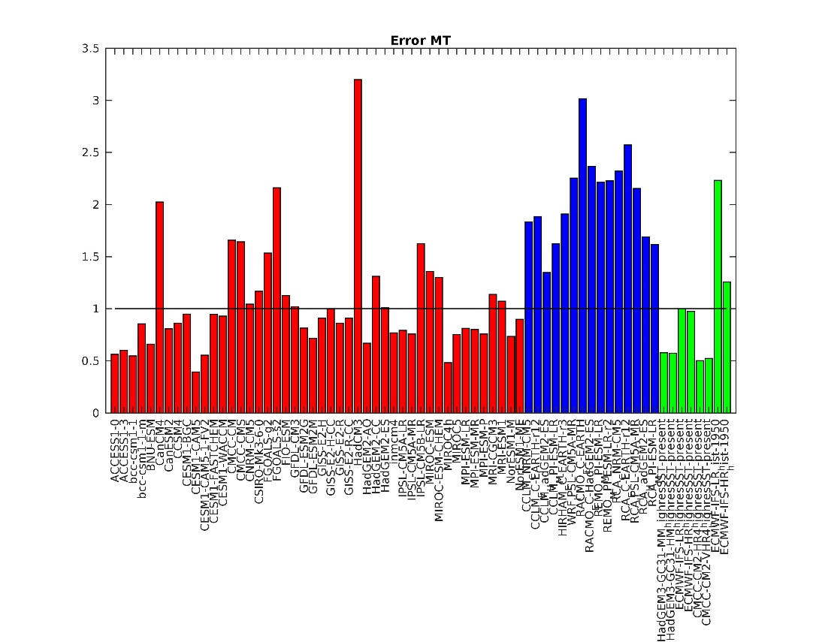
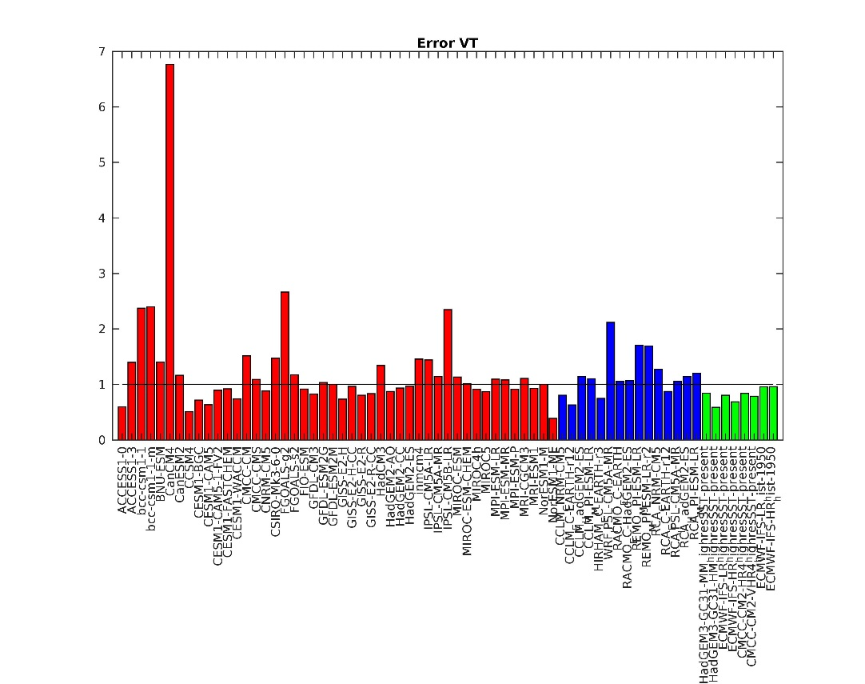
Hydrological impact over the upper Danube basin
Normalized overall error as compared with CRU TS3.25 at the basin scale (1950-2005)
Mean temperature
Temperature variability
CMIP5
CORDEX
PRIMAVERA
Notes:
PRIMAVERA represents variability better than mean temperature. PRIMAVERA outperforms CORDEX.

Slide 23
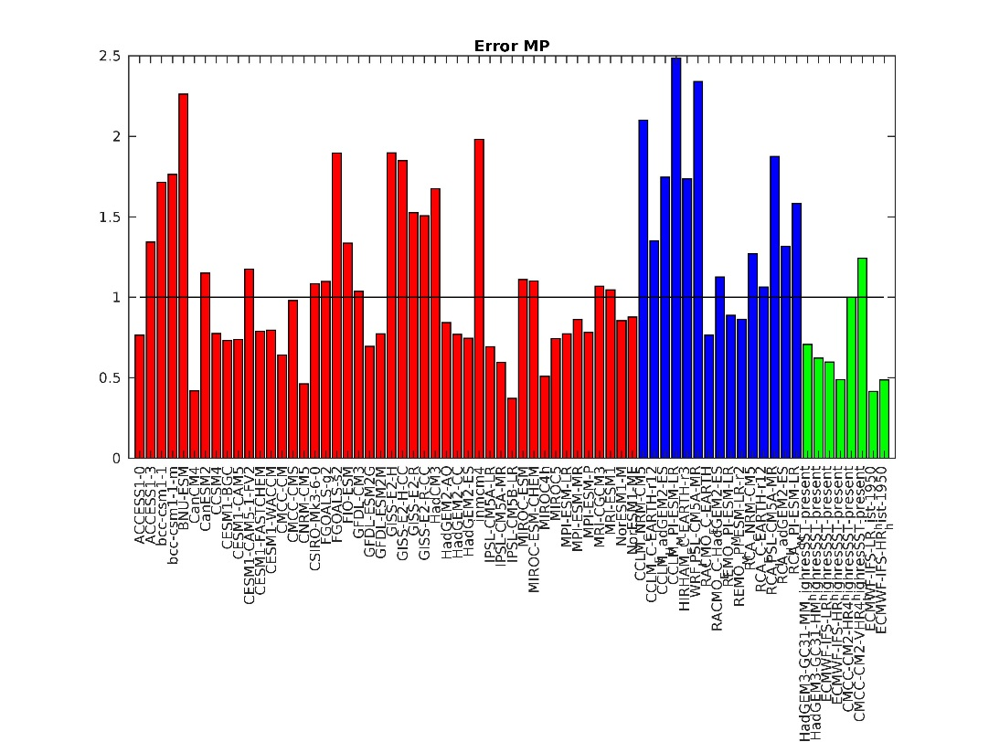
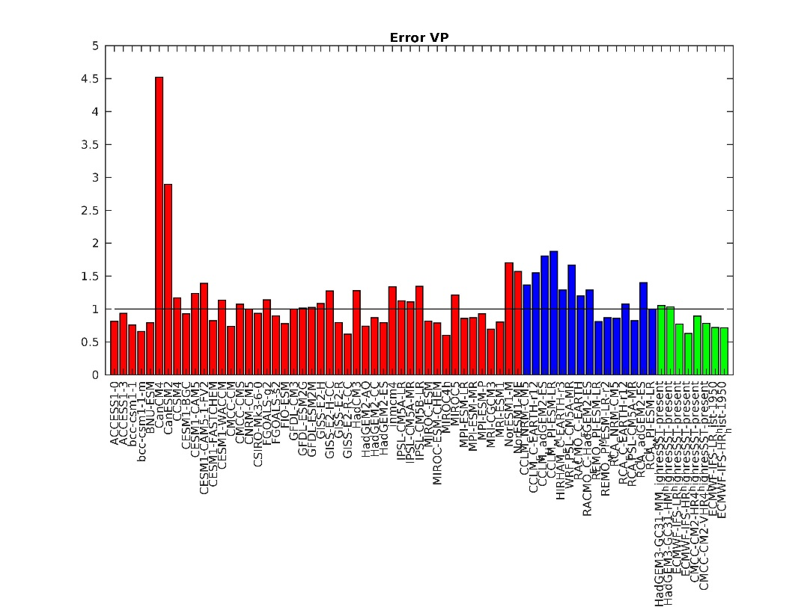
Hydrological impact over the upper Danube basin
Normalized overall error as compared with CRU TS3.25 at the basin scale (1950-2005)
Mean precipitation
Precipitation variability
CMIP5
CORDEX
PRIMAVERA
Notes:
PRIMAVERA represents variability better than mean precipitation. PRIMAVERA outperforms CORDEX.

Slide 24
summary
The general improvement of having higher resolution can be difficult to quantify – is it enough that it looks better?
Improvements for specific processes are easier to quantify:
  Extreme precipitation is better reproduced by high resolution models.
  Extra Tropical Cyclones are better represented in the PRIMAVERA models compared to CMIP5
  A study over the Danube basin shows that the PRIMAVERA models even outperform the CORDEX RCM for a selection of climate variables

Slide 25
Thanks for listening!
Are there questions?

